Slide 1
Java - Classes

Slide 2
OO Programming Concepts
Object-oriented programming (OOP) involves programming using objects.
An object represents an entity in the real world that can be distinctly identified.
For example, a student, a desk, a circle, a button, and even a loan can all be viewed as objects.
An object has a unique identity, state, and behaviors.
The state of an object consists of a set of data fields (also known as properties) with their current values.
The behavior of an object is defined by a set of methods.

Slide 3

Objects
An object has both a state and behavior.
The state defines the object, and the behavior defines what the object does.

Slide 4
Classes
Classes are constructs that define objects of the same type.
A Java class uses variables to define data fields and methods to define behaviors.
Additionally, a class provides a special type of methods, known as constructors, which are invoked to construct objects from the class.

Slide 5
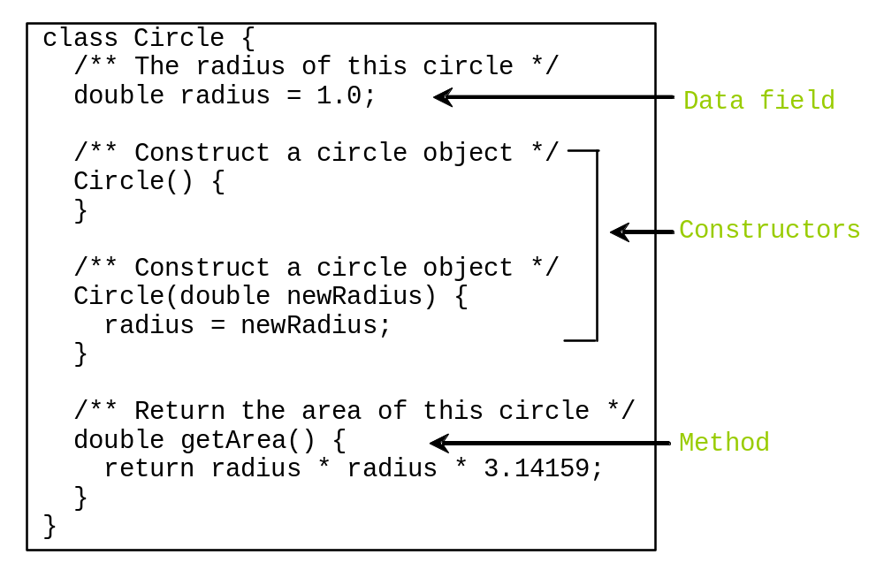
Classes

Slide 6
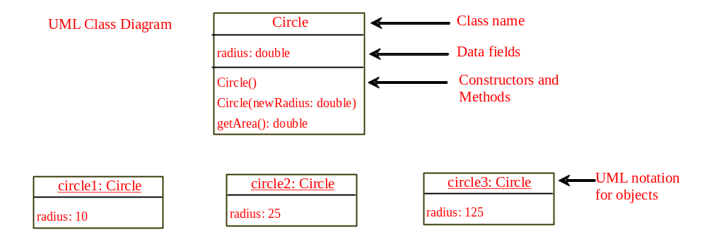
UML Class Diagram

Slide 7
Constructors
Constructors are a special kind of methods that are invoked to construct objects.
Circle() {
}
Circle(double newRadius) {
radius = newRadius;
}

Slide 8
Constructors, cont.
A constructor with no parameters is referred to as a no-arg constructor.
Constructors must have the same name as the class itself.
Constructors do not have a return type—not even void.
Constructors are invoked using the new operator when an object is created. Constructors play the role of initializing objects.

Slide 9
Creating Objects Using Constructors
new ClassName();
Example:
new Circle();
new Circle(5.0);

Slide 10
Default Constructor
A class may be declared without constructors.
In this case, a no-arg constructor with an empty body is implicitly declared in the class.
This constructor, called a default constructor, is provided automatically only if no constructors are explicitly declared in the class.

Slide 11
Declaring Object Reference Variables
To reference an object, assign the object to a reference variable.
To declare a reference variable, use the syntax:
ClassName objectRefVar;
Example:
Circle myCircle;

Slide 12
Declaring/Creating Objects in a Single Step
ClassName objectRefVar = new ClassName();
Example:
Circle myCircle = new Circle();
Assign object reference
Create an object

Slide 13
Accessing Objects
Referencing the object’s data:
objectRefVar.data
e.g., myCircle.radius
Invoking the object’s method:
objectRefVar.methodName(arguments)
e.g., myCircle.getArea()

Slide 14
Example : A Simple Circle Class
Objective: Demonstrate creating objects, accessing data, and using methods (Circle1, TestCircle1).

Slide 15
Trace Code
Declare myCircle
Circle myCircle = new Circle(5.0);
Circle yourCircle = new Circle();
yourCircle.radius = 100;
myCircle
no value

Slide 16

Trace Code, cont.
Circle myCircle = new Circle(5.0);
Circle yourCircle = new Circle();
yourCircle.radius = 100;
myCircle
no value
Create a circle

Slide 17
Trace Code, cont.
Circle myCircle = new Circle(5.0);
Circle yourCircle = new Circle();
yourCircle.radius = 100;
myCircle
reference value
Assign object reference to myCircle

Slide 18
Trace Code, cont.
Circle myCircle = new Circle(5.0);
Circle yourCircle = new Circle();
yourCircle.radius = 100;
myCircle
reference value
yourCircle
no value
Declare yourCircle

Slide 19
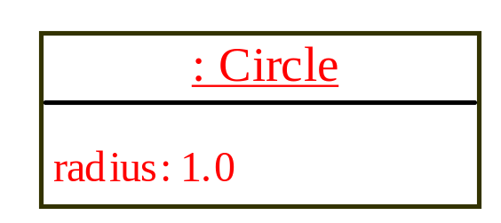
Trace Code, cont.
Circle myCircle = new Circle(5.0);
Circle yourCircle = new Circle();
yourCircle.radius = 100;
myCircle
reference value
yourCircle
no value
Create a new Circle object

Slide 20

Trace Code, cont.
Circle myCircle = new Circle(5.0);
Circle yourCircle = new Circle();
yourCircle.radius = 100;
myCircle
reference value
yourCircle
reference value
Assign object reference to yourCircle

Slide 21

Trace Code, cont.
Circle myCircle = new Circle(5.0);
Circle yourCircle = new Circle();
yourCircle.radius = 100;
myCircle
reference value
yourCircle
reference value
Change radius in yourCircle

Slide 22
Caution
Recall that you use
  Math.methodName(arguments) (e.g., Math.pow(3, 2.5))
to invoke a method in the Math class.
Can you invoke getArea() using Circle.getArea()?
The answer is no. All methods used earlier in the lectures are static methods, which are defined using the static keyword. However, getArea() is non-static. It must be invoked from an object using
  objectRefVar.methodName(arguments) (e.g., myCircle.getArea()).

Slide 23
Reference Data Fields
The data fields can be of reference types. For example, the following Student class contains a data field name of the String type.
public class Student {
String name; // name has default value null
int age; // age has default value 0
boolean isScienceMajor; // isScienceMajor has default value false
char gender; // c has default value '\u0000'
}

Slide 24
The null Value
If a data field of a reference type does not reference any object, the data field holds a special literal value, null.

Slide 25
Default Value for a Data Field
The default value of a data field is
null for a reference type
0 for a numeric type
false for a boolean type
'\u0000' for a char type
However, Java assigns no default value to a local variable inside a method.
public class Test {
public static void main(String[] args) {
Student student = new Student();
System.out.println("name? " + student.name);
System.out.println("age? " + student.age);
System.out.println("isScienceMajor? " + student.isScienceMajor);
System.out.println("gender? " + student.gender);
}
}

Slide 26
Example
Java assigns no default value to a local variable inside a method.
public class Test {
public static void main(String[] args) {
int x; // x has no default value
String y; // y has no default value
System.out.println("x is " + x);
System.out.println("y is " + y);
}
}
Compilation error: variables not initialized

Slide 27

Differences between Variables of
Primitive Data Types and Object Types

Slide 28

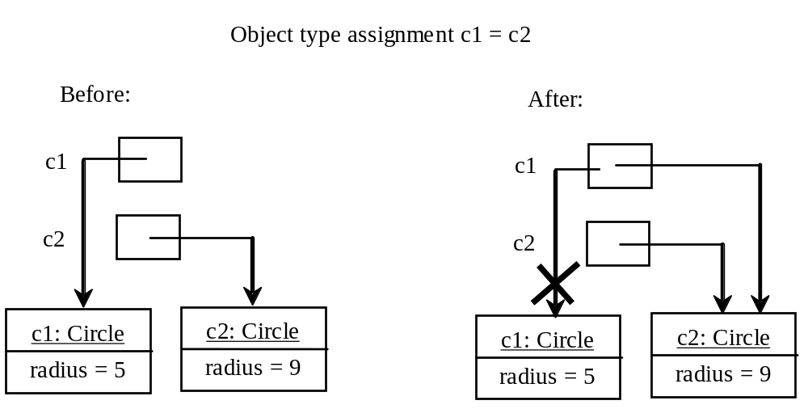
Copying Variables of Primitive Data Types and Object Types

Slide 29
Garbage Collection
As shown in the previous figure, after the assignment statement c1 = c2, c1 points to the same object referenced by c2.
The object previously referenced by c1 is no longer referenced.
This object is known as garbage. Garbage is automatically collected by JVM.

Slide 30
Garbage Collection, cont
TIP: If you know that an object is no longer needed, you can explicitly assign null to a reference variable for the object. The JVM will automatically collect the space if the object is not referenced by any variable.

Slide 31
Instance
Variables, and Methods
Instance variables belong to a specific instance of a class.
Instance methods are invoked by an instance of the class.

Slide 32
Static Variables, Constants, and Methods
Static variables are shared by all the instances of the class.
Static methods are not tied to a specific object.
Static constants are final variables shared by all the instances of the class.
To declare static variables, constants, and methods, use the static modifier.

Slide 33
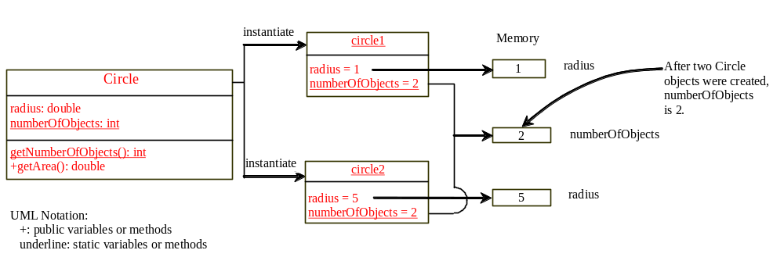
Static Variables, Constants, and Methods, cont.

Slide 34
Example - Using Instance and Class Variables and Method
Objective: Demonstrate the roles of instance and class variables and their uses.
This example (TestCircle2) adds a class variable numberOfObjects to track the number of Circle objects created.

Slide 35
Visibility Modifiers and
Accessor/Mutator Methods
By default, the class, variable, or method can be
accessed by any class in the same package.
public
The class, data, or method is visible to any class in any package.
private
The data or methods can be accessed only by the declaring class.
Example: The get and set methods are used to read and modify private properties. (Accessor/Mutator methods)

Slide 36
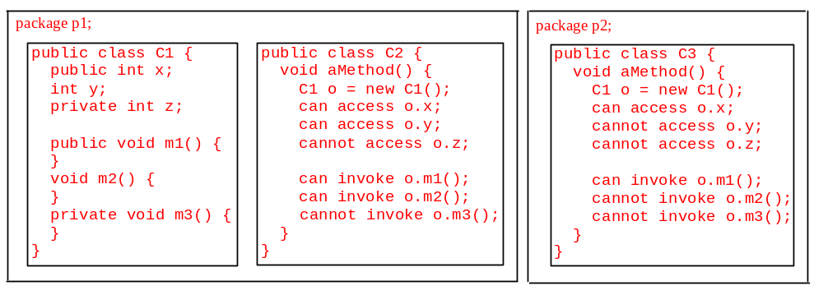
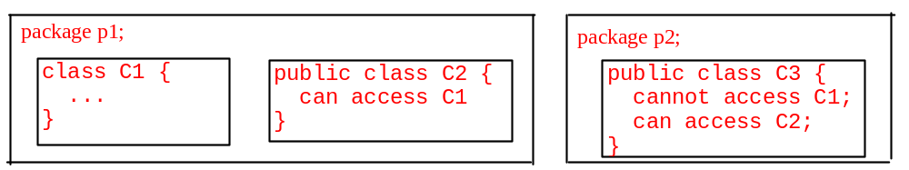
The private modifier restricts access to within a class, the default modifier restricts access to within a package, and the public modifier enables unrestricted access.

Slide 37
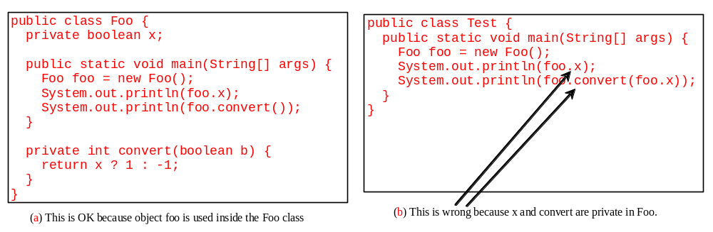
NOTE
An object cannot access its private members, as shown in (b).
It is OK, however, if the object is declared in its own class, as shown in (a).

Slide 38
Why Data Fields Should Be private?
To protect data.
To make class easy to maintain.

Slide 39

Example - Data Field Encapsulation (TestCircle3)

Slide 40
Passing Objects to Methods
Passing by value for primitive type value (the value is passed to the parameter)
Passing by value for reference type value (the value is the reference to the object)

Slide 41
Array of Objects
Circle[] circleArray = new Circle[10];
An array of objects is actually an array of reference variables.
So invoking circleArray[1].getArea() involves two levels of referencing as shown in the next figure.
circleArray references to the entire array.
circleArray[1] references to a Circle object.

Slide 42
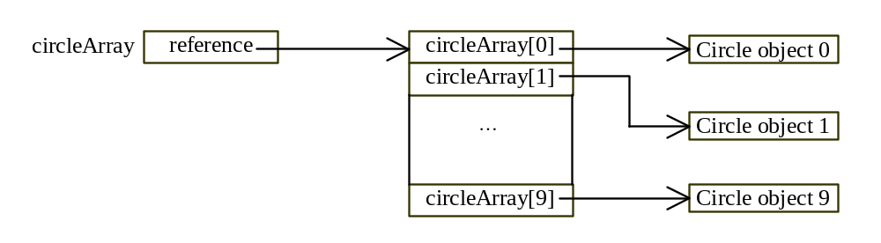
Array of Objects, cont.
Circle[] circleArray = new Circle[10];

Slide 43
Example - Array of Objects
Objective: Calculate the total of the areas of circles in an array (TotalArea)

